Slide 1


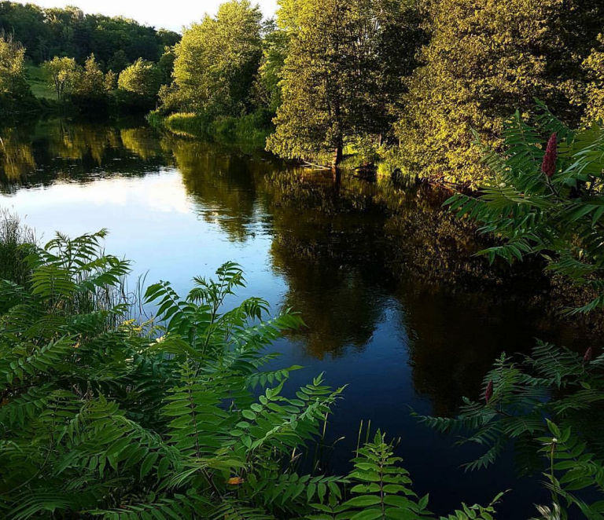
OFFICIAL PLAN UPDATE – PUBLIC MEETING

Slide 2
Official Plan (OP) Review & Update
The 2016 TVT OP requires updating to conform to the 2020 Provincial Policy Statement
Jp2g Consultants Inc has led the Official Plan Update:
  Special Meeting to notify public of intent to review the OP – September 21, 2021
  Public Comments – October 15, 2021
  Issues and Options Report to Council – December 7, 2021, Direction January 25, 2022
  Growth Management Options Report – February 8, 2022
  Draft Official Plan Amendment Review by Council – April 19 & May 3, 2022
  Open House – in person – June 9, 2022
  Open House – virtual – June 14, 2022
  Public Meeting – June 21, 2022

Slide 3
Official Plan (OP) Review & Update
Comments are welcome until June 30, 2022
Following this formal Public Meeting, Council will consider comments received and determine what changes they may wish to make to the OPA prior to adopting the amendment in August or September
Following the adoption of the OPA, the document will be forwarded to Lanark County for final approval.

Slide 4
New Policies Required by PPS 2020
The Provincial Policy Statement (PPS) 2020 introduced a number of new policies which local Official Plans are required to address:
  Indigenous consultation and engagement in the planning approval process (p. 9-12, 15, 21, 53, 97; photos p. 22, 98)
  Climate Change (p.18, 30-32), Wildlands Fire Hazard (p. 92-93), Emergency Management (p.93 )
  Expanded range of permitted uses for agricultural industry (p. 102 )
These matters have been discussed by Council and included in the draft OPA

Slide 5
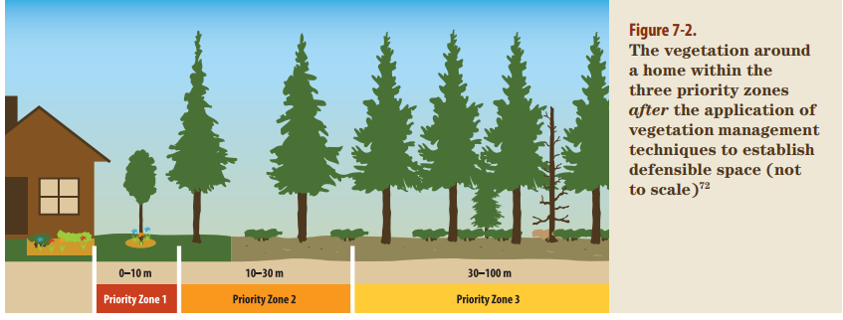

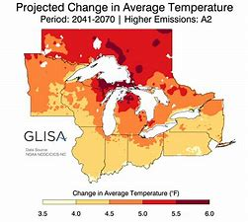
What’s New – PPS Policies
Wildland Fire Risk Mitigation
On Farm Diversified Uses
Climate Change

Slide 6
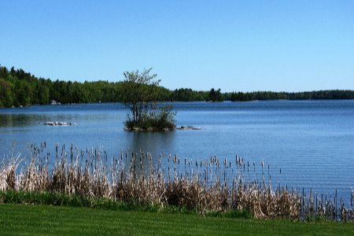
What’s New – Ministry and Council Review
Additional text and map changes are included in the draft OPA:
  Overhaul of policies regulating waterfront – enhanced focus on net environmental gain (p. 63-67)
  Role Lanark County plays as the upper tier approval authority (p. 14)
  Recognition of Recreation Master Plan & enhanced recreation policies (p. 72-75)

Slide 7
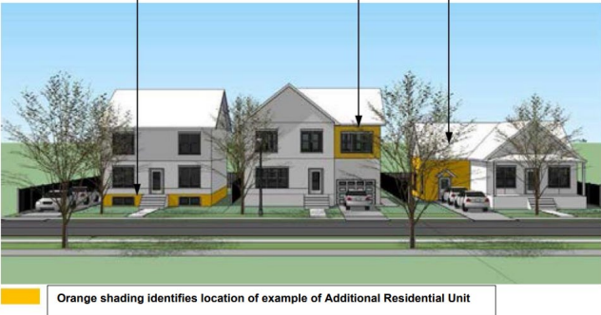
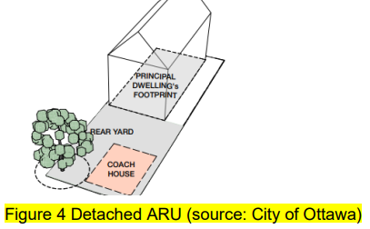
What’s New – Ministry and Council Review
  Policies related to contaminated sites (p. 93-95)
  Clarification of the triggers for hydrogeological assessments (p. 80)
  Enhanced policies related to stormwater management (p. 82-85)
  Enhanced policies for affordable housing & Additional Residential Units (p. 28-29)
  New Natural Heritage System Maps for South Sherbrooke and west Bathurst (p.139)
  General administrative changes and document reorganization

Slide 8
Growth Management Policies
Council reviewed the consent policies for the Township and proposed:
  Enhanced protection of rural character
  Definition of the term “strip development”
  Enhanced cluster lot development policies
  Maintaining the effective date for lots created by consent
Council also decided to undertake a Comprehensive Review to consider options for a Township wide growth strategy following the update of the Official Plan.
The Township’s Growth Management Options Report is available on the OP Review and Update web page
  https://www.tayvalleytwp.ca/OfficialPlanReview/

Slide 9
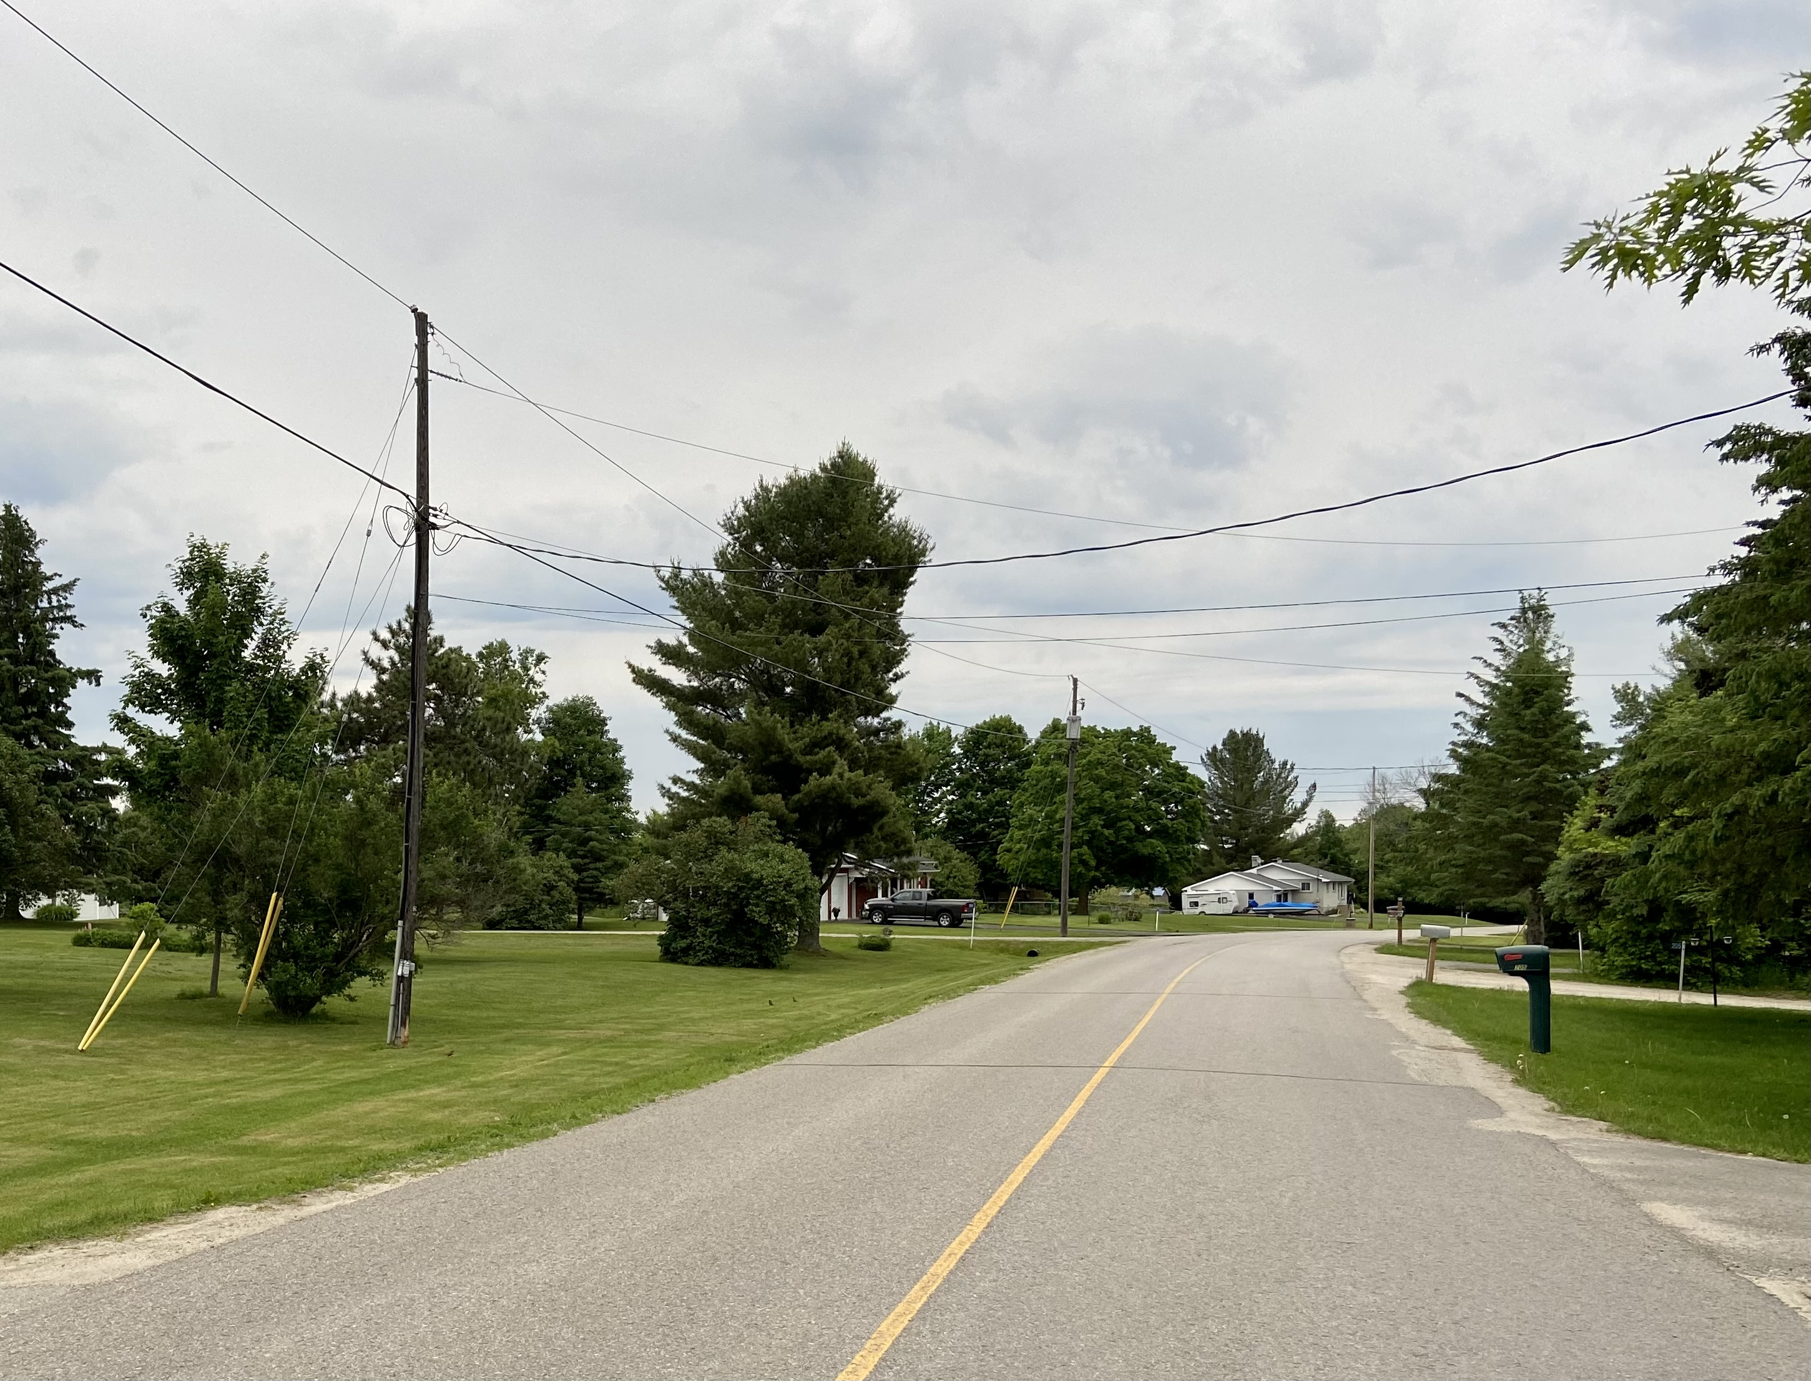
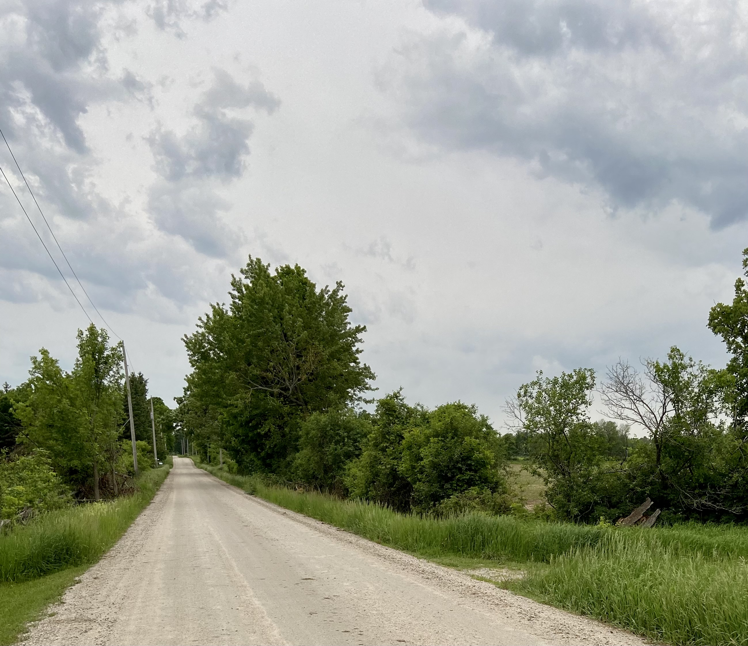
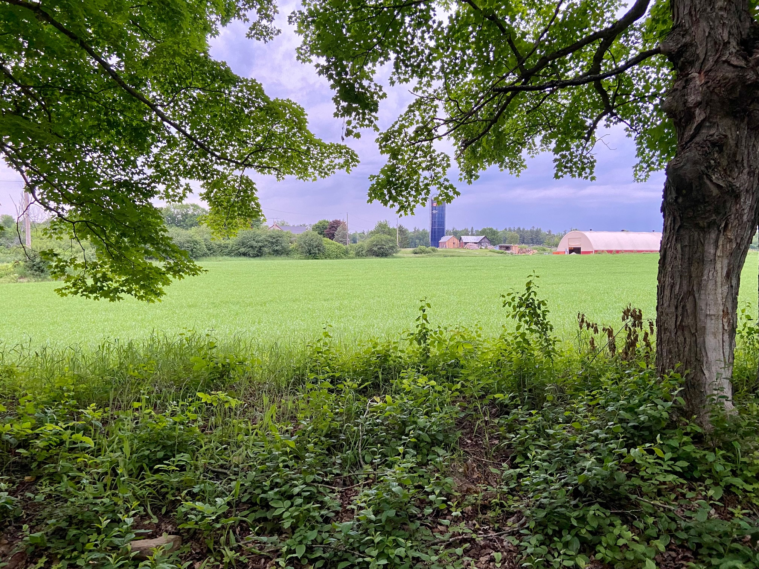
Strip vs Rural Landscape
Strip development is defined as a series of four (4) or more developed or undeveloped residential lots located on one side of a public road within a 300-metre length.
No new residential lot shall be created within a 300-metre distance of strip residential development located on the same side of the road.
Strip development
Clarchris Road
east end
Rural landscape
Clarchris Road
west end

Slide 10
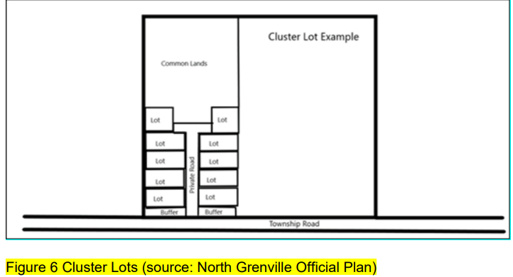
Cluster Lot Development
Cluster lots are set back 100m (300ft) from a Township road with a vegetated buffer to prevent the driver on the road from seeing them. This maintains a rural landscape through a common land condominium.

Slide 11
Public Comments
The Township has received comments from 46 individuals, 3 lake associations, and 1 Working Group, on a range of topics.
Waterfront Development
  existing lot areas below 0.3 ha (0.74 acres) should not be permitted to convert to permanent use from seasonal use
  need strong policies to retain natural shorelines, tree canopy of 30-35%, control maximum lot coverage
  no Additional Residential Units on private roads and waterfront lots
Significant Woodlands – should be identified on the schedules for all the Township for transparency
Consultation with Indigenous Groups – should be collaborative and recognize Indigenous protocols

Slide 12
Public Comments
Residential Intensification – should be promoted in Hamlets
Growth Management – add phasing policies to ensure take up of existing lots before approval of new lots
Climate Change
  add tree planting and canopy cover targets
  have the strongest policies possible for built form, growth management, sustainable infrastructure
  replace Township vehicles, buildings and waste management practices with climate friendly alternatives

Slide 13
Public Comments
Climate Change
  The Climate Action Plan initiatives and goals should be in the OP
  Objectives should include;
    reduce use of fossil fuels,
    convert to clean energy systems,
    provide for net zero emission buildings and green building design,
    incorporate green energy technologies into all land use planning decisions,
    provide for local food security,
    reduce, reuse, and recycle all forms of waste,
    design and develop active transportation systems,
    promote mitigation best practices for farming, commercial and industrial processes,
    promote resiliency.
Nature Based Climate Solutions - should be emphasized e.g., increase forest coverage, sustain high levels of carbon capture by protecting wetlands, etc.

Slide 14
Public Comments
Recreation
  Consider trail classification as well as park classification, e.g., back country biking trails are gaining popularity.
  Integrate municipal facilities with Crown Lands and islands.
  Develop active transportation connectivity between existing parks and Crown lands.
  Support retention of navigable waterways, water levels and flows, notably along the Tay Watershed, providing public accessibility for boating and fishing.
Biodiversity – Support fish and wildlife habitat improvements.
Economic Development – Identify the economic base and how to strengthen local economy through tourism, ecotourism, rural-based commercial and industrial uses, home based businesses and services tailored to work-at-home trends.
Healthy Communities – should be a section stating what sustains a healthy community and indices to monitor.
Accessibility – Official Plan should reflect the Accessibility Plan, reflect commitment to upgrade facilities.
Section 5.3 Deeming Plans of Subdivision – Resident disagrees with it in light of Section 50(4) of the Planning Act.

Slide 15
Public Comments
Promote carpooling – allow car parks at commuting intersections
Promote rural transportation – minivans and shuttle services
Encourage adaptive re-use of buildings - as an alternative to new construction
Design - road infrastructure and stormwater management facilities to protect against severe weather events and to facilitate evacuation
Adopt green standards - for construction (with density incentives)
Asset Management - modify the Municipal Asset Management Plan to provide for infrastructure replacement needed to mitigate impacts of severe climate events.
Regulate short-term rentals (Airbnb, VRBO)
  before TVT becomes Prince Edward County
  lake capacity and other impacts should be considered
Aggregate designation – Fagan Lake Road. MNRF recommends removal of designation

Slide 16
Public Comments
VIA Rail – concern over proposal impacts on existing and new development
Agricultural Designation – Ferrier Road East removal of designation for 1 lot
Housing – more affordable housing is needed
Diversity – the Official Plan introduction could include information on diversity in the Township: minorities, country of origin, number of mother tongues, and Indigenous residents
Septic Re-Inspections – should be phased in as mandatory on all water bodies
Community Planning Permit System – Tay Valley should consider implementing this system (also known as a Development Permit System) currently used by Carleton Place
Condominium Roads – Language in current Official Plan does not match intention to allow creation of private roads

Slide 17
Green Energy Climate Change Working Group Comments
Climate change – Include guiding principles in the Official Plan similar to Lanark County’s:
  Tay Valley Township will eliminate fossil fuel use;
  Tay Valley Township will maximize energy efficiencies and increase renewable energy generation;
  Tay Valley Township will sequester carbon and protect natural resources;
  Tay Valley Township will reduce waste organic material.
Emergency Management - include reference to the need to prepare for emergencies arising from a changing climate (e.g., flooding, derecho windstorms, heat domes, etc).
.

Slide 18
Lake Association Comments
Adam Lake: Existing legacy cottage developments should not be held to a septic standard that existed when they were installed. Increased Floor Space Ratio may encourage redevelopment and, therefore, new septic systems.
Big Rideau Lake:
  Climate Change is affecting surface water quality, suggesting the need for new, more comprehensive approaches. The Ministry of Environment Conservation and Parks has indicated that the phosphorus model can no longer be defended so the more recent Lake Health approaches used in Muskoka and the science by Dr. John Smol of Queen’s University should be considered.
  Look at Rideau Lake’s new Official Plan policies on cottage redevelopment based on the report by Donnelly Law.
  Lower Rideau is identified by RVCA as having very poor water quality. As the recipient of the impacts of all upstream nutrient inputs, including the entire Tay watershed, a comprehensive review of policies affecting development in the southern part of the Township is warranted.

Slide 19
Lake Association Comments
Big Rideau Lake:
  The Water Setback policies should be reviewed to ensure a net environmental gain is mandatory when a reduction to the 30 m setback is to be considered.
  Stronger statements to implement shoreline alteration by-laws under the Municipal Act would be welcomed. Haliburton has made good progress on this.
  Stormwater management policies should reduce nutrients that flow into waterbodies from public roads, agricultural drains and private roads.
  Residential policies should avoid additional units or other intensification in waterfront areas (lands with the most potential to impact surface water quality).
Little Silver and Rainbow Lakes: They are pleased their Lake Management Plan has been added to Appendix D. They have concerns about their lake’s development status with respect to phosphorus.

Slide 20
Current Mapping
Currently the Township’s Official Plan has two schedules for each ward:
  Schedule A which is the land use schedule (rural, hamlet, employment lands, agriculture, mineral aggregate, Provincially Significant Wetlands) and,
  Schedule B which combines environmentally sensitive lands (organic soils, wetlands, woodlands, ANSI, deer yards), plus land use constraints (such as abandoned mines, floodplain, waste site setbacks, etc.).

Slide 21
Mapping Changes
These two schedules are proposed to be replaced by three new schedules, on new, highly accurate maps showing the Township on one map per schedule:
  New Schedule A will continue to be the Land Use schedule (Rural, Hamlet, Employment Lands, Agriculture, Active Pits and Quarries, Provincially Significant Wetlands)
  New Schedule B will be a Constraints Schedule (Organic Soils, Abandoned Mines, Waste Disposal Sites, Aggregate Resources, Bedrock Resources, Intake Protection Zones, Wildland Fire Hazard, Floodplains)
  New Schedule C will be the Natural Heritage System Schedule (Wetlands, ANSI, Significant Woodlands, Locally Significant Natural Areas, Community Forest, Provincial Parks, waterbodies and Natural Corridors and Linkages)

Slide 22
Schedule A – Land Use

Slide 23
Schedule B – Development Constraints

Slide 24
Schedule C – Natural Heritage Features

Slide 25
Next Steps
Council would like to encourage the public to provide comments on the Draft Official Plan by June 30, 2022, to ensure they are captured prior to Council considering the adoption of the draft Official Plan.
Council will review comments provided and will determine what changes, if any, should be made to the draft Official Plan (at a regular Committee of the Whole meeting in August or September).
Once adopted, Council will forward the adopted Official Plan to Lanark County for final approval. Those individuals not in agreement with the adopted Plan have an opportunity to express their concerns to Lanark County prior to its approval.
Once approved by Lanark County, there will be a posted notice identifying the appeal process for any public or agencies not supportive of the approved Plan. All appeals would be forwarded to the Ontario Land Tribunal (OLT) for further consideration.

