Slide 1
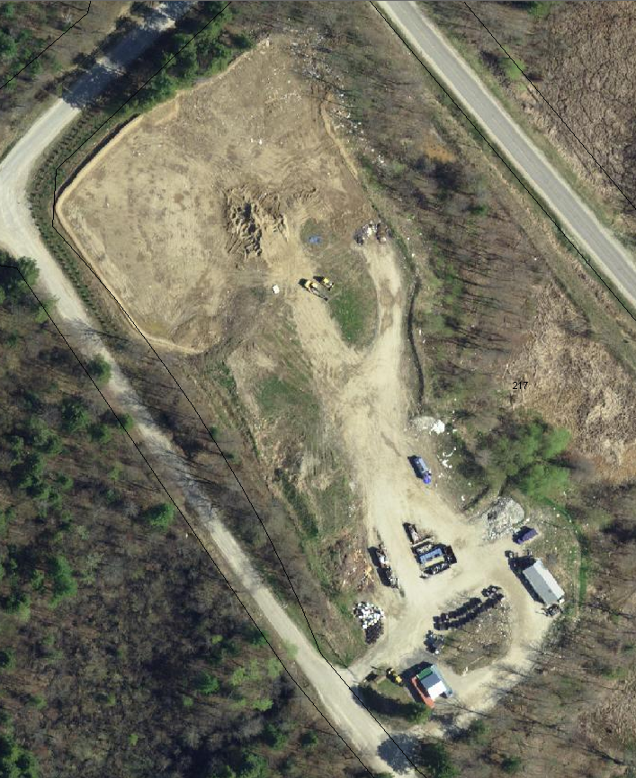
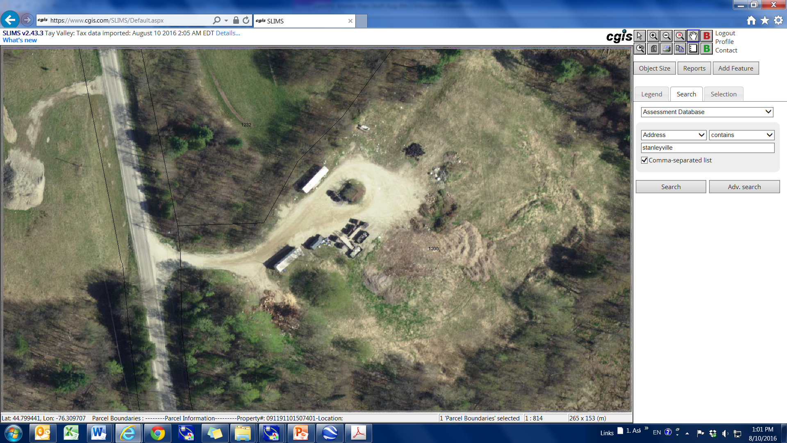
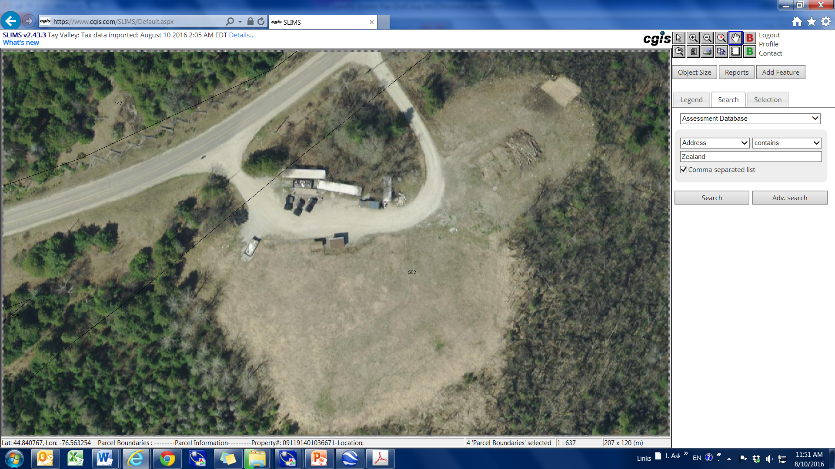

Tay Valley Township
Landfill Master Plan
March 7th, 2017
Glen Tay
Stanleyville
Maberly

Slide 2
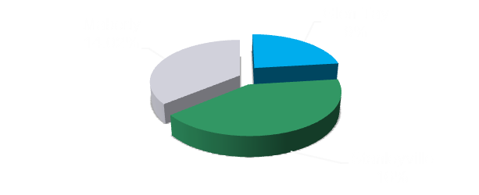
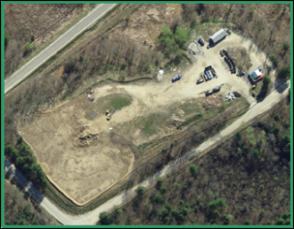
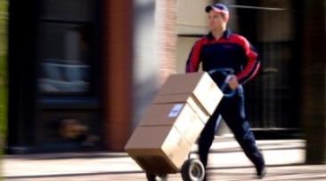
Agenda(s) August 21st VS. 2016 March 7th 2017
Operational Review
Five landfills – Closed sites- Open Sites - Winter Operations – Summer Operations -Waste, Shingles - BB, Metal, Glass, Tires, Reuse, Batteries, C&D, Appliances– Transport of Waste, BB & Other Diversion - Scrap Tonnages 833t Waste 804t Diversion ---- Remaining Capacity - 177000 m3 – 154000m3 - 5900m3 - 45 Years
Strategic Plan – Implications
Remaining Life - Reuse Centre - Yearly Contribution $25000 Closure Costs - Reuse Centre 20 t/y - Weigh Scale - Waste Audit - - Diversion of Organic - Additional Recyclables - Public Education – Environmental Stewardship – Cover Cost – Cost of Waste Streams.
Regulatory Framework – Including Bill 151
EPA – OD legal – Operations Phase 1 of Site - Compliance Issue OR 101/94 50% reduction – High Expectations - OR 232/98 OD surveys - Bill 90 3R waste diversion – MOE Guidelines B7 & B9 Provincial Water Quality Standards. Bill 151 Evolving tonne – Waste Free Ontario – WDO → Authority Producer responsibility
Landfill Financial Model – 3 Segment Model
Model Scenario Outcomes
Baseline, Increased C&D Revenue, Full Utilizations of Compactor, Thursday Only Cover, Two Compactors, Weigh Scale, 10% waste to recycling Roll off IBS – Dedicated Roll-Off for Waste , C&D, Metal , MURF, Waste Diversion Contractor Curb Side Curbside Pickup with Loan and Depreciation
Future Plan(s) & Summary

Slide 3


Agenda – March 7th, 2017
Cost Savings & Service Delivery Through:
Operational Considerations
Transportation
Curbside Pickup
Increased Service Delivery at Low Cost !

Slide 4
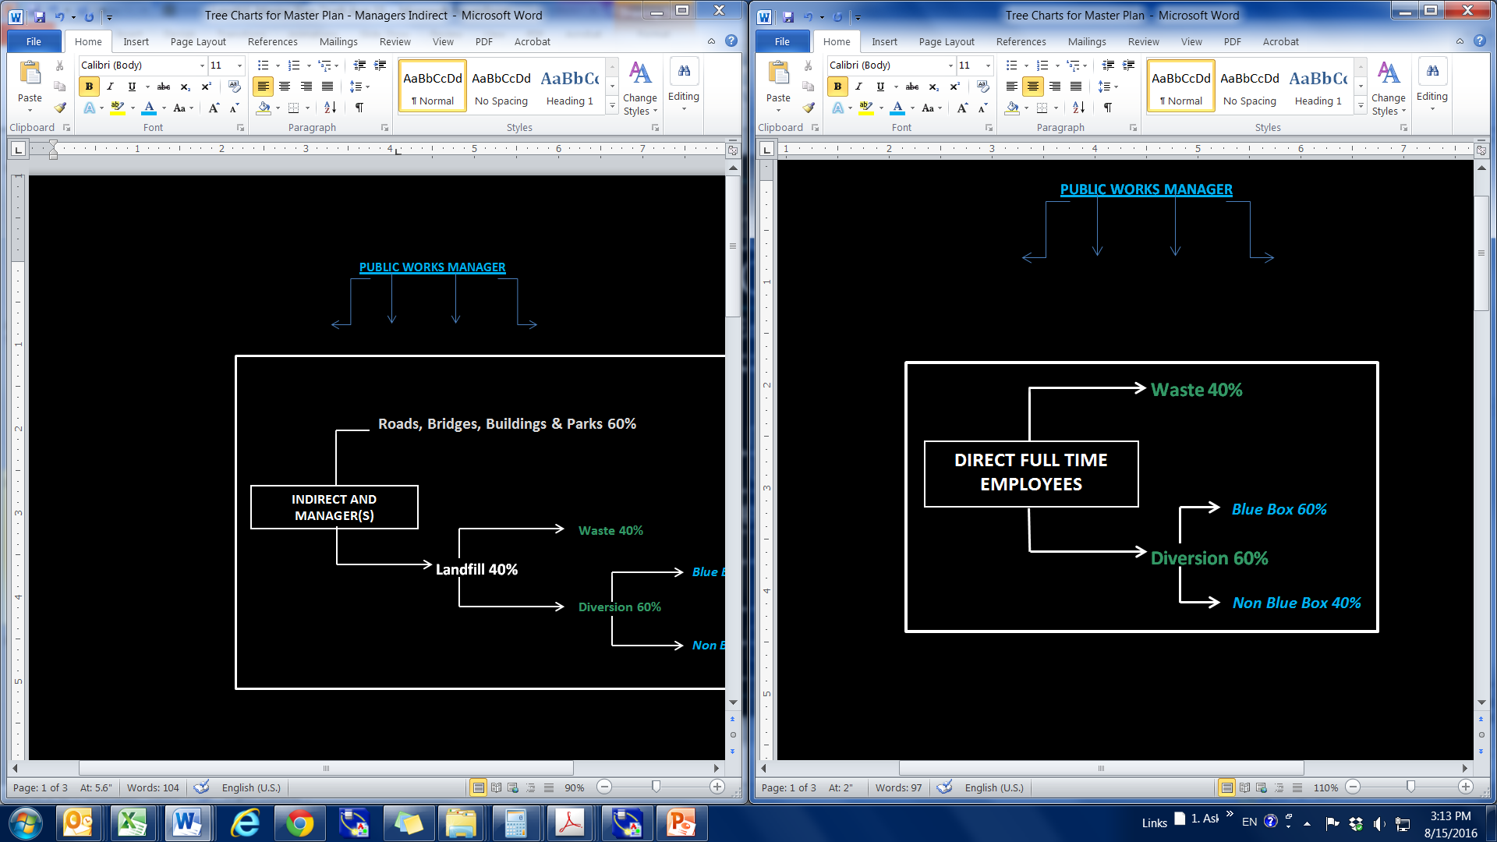
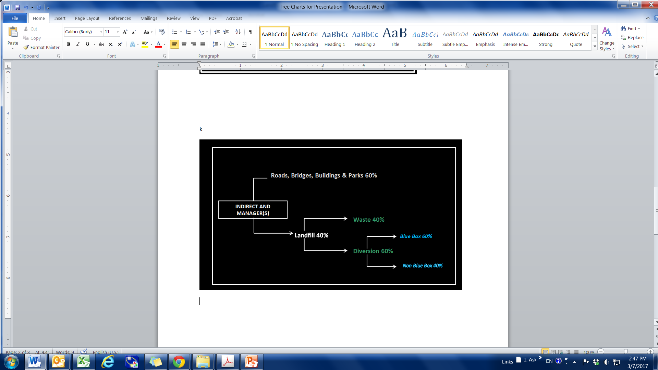
Landfill Model
3 Segments – Labour Division
Three Segments Model: 1. Waste
2. Blue Box Diversion
3. Non Blue Box Diversion
Direct Labour Allocation 4 (FTEs) Indirect and Manager Allocations 2 FTEs
40% to Landfills

Slide 5
Landfill Model Baseline
Total Landfill Net Cost $548k/y
  Waste Net Cost $310k/y
    Waste/Tonne $379/t
  Blue Box Net Costs $130k/y
    BB/Tonne $494/t
  Non Blue Box Diversion Net $108k/y
    NBB Diversion/Tonne $193/t

Slide 6
Operational Changes
Glen Tay Net Savings Unit Savings Additive1 Additive2
Compactor Fully Utilized $8,805/y $8,805/y
One Day Waste Cover $8,800/y $17,600/y
Increase C&D Revenue $24,000/y $41,600/y
Second Compactor $10,800 $43,586/y

Slide 7
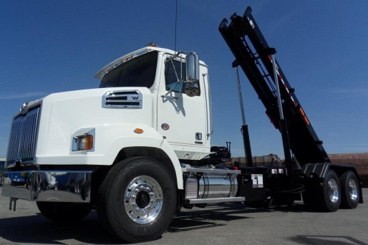
Roll-Off Truck
Roll-Off $150,000 Purchase
  Roll-Off – Waste Transport ($/y)
    Total 7,575
  Roll-Off – Metal and C&D ($/y)
    Total -17,000
    Aggregate Total - 9,400

Slide 8
Curbside Pickup
Examples
Municipal Curbside Approaches
  Drummond North Elmsley
    Contractor Picks Up and Places Waste and Recycling at Municipal Waste Site
    Approximately a $740,000 increase in expenditure to the residents
      $190/Household, shown on tax bills
  Rideau Lakes Township
    Municipal Personnel Pick Up Waste and Two Stream Recycling and Deliver to Municipal Waste Site
    Using side entry trucks

Slide 9
Curbside Pickup
Personnel Considerations
Curbside
  Reallocation of personnel – This is key for Tay Valley!
    Close Stanleyville & Maberly Sites
    Glen Tay open Saturday & Wednesday (Potentially Sunday in the Summer)
    2.5 employees 2080 h/y on trucks
    2 employees 2.4 days/week at Glen Tay
    Alternately the operation can remain Status Quo and two employees can be hired for Roadside costing an additional
    ~$127,000/y

Slide 10
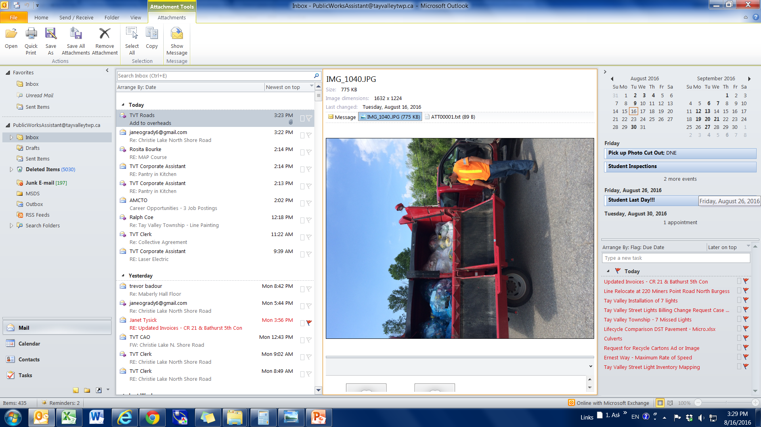
Curbside Costs
Curbside Pickup
  Debenture purchase of trucks @ $260,000
    Depreciation $26,000/y
    Loan Repayment $33,000/y
    Supplies $20,000/y
    Labour $27,000/y
    Insurance $2,000/y
    Total $108,000/y
    After fully depreciated $75,000/y

Slide 11
Improvements & Curbside - 2015
Status Quo - net cost - $548,000/yr.
  Capital Cost Yearly Cost
  Operational Improvements $40k - $43,000/y
Transport of Waste, C&D, Metal
  Roll-off for Waste $150k -$38,000/y
  Roll-off for C&D Metal -$55,000/y
Curbside Pickup
  Purchase of trucks $260K $53,000/y
  Ramp $50k $66,000/y
  Bins $60k $83000/y
  2.50 $/bag -$180,000/y
  Net Cost after Curbside … $401,000/y
  $147,000 reduction in overall net cost.

Slide 12
Improvements & Curbside - 2018
Increases in Wages, Lifts and Decrease in Bags by 20%
Status Quo - net cost - $568,000/yr. Yearly Cost
  Operational Improvements - - $47,000/y
Transport of Waste, C&D, Metal
  Roll off for Waste $160,000 -$39,000/y
  Roll off for C&D Metal fuel-maint’ -$55,000/y
Curbside Pickup
  Purchase of Trucks $250,000 $51,000/y
  Ramp $50,000 $65,000/y
  Bins $60,000 $81,000/y
  2.50 $/bag -$119,000/y
  Net Cost after Curbside … $449,000/y
  $119,000 reduction in net cost.

Slide 13
Conclusions
Curbside Pickup – Significant Increase in Service Delivery
RFP/Tender – Recycling
  Roll-Off as Provisional Item of Tender/RFP
Flat Fees for C&D Waste
Second Compactor at Glen Tay Waste Site
Continue to Shave Costs of MOECC Monitoring
  Municipally Shared Hydrogeologist
Reinstate Organic Home Composting Program
Reuse Centre – Icon of the Community

Slide 14
Curbside Summary
Curbside Pickup
  Provides necessary service to the aging population and attractive service to busy families
    Long term risk to not have curbside in place
  Environmentally responsible
    2 trucks rather than 1000s of cars/wk
  Major increased service delivery to the community as a whole.
  THE END

